Slide 1
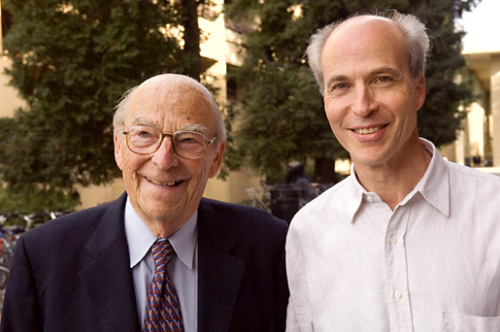

Slide 2
How can DNA Specify the Production of Proteins?
The idea that RNA acts as an intermediate was suggested by the following findings in eukaryotic cells:
DNA is mostly associated with chromosomes in the nucleus while ribosomes that generate proteins are in the cytoplasm.
RNA is synthesised in the nucleus.
RNA migrates to the cytoplasm where proteins are synthesised.
The amount of RNA is generally proportional to the amount of protein in a cell.

Slide 3
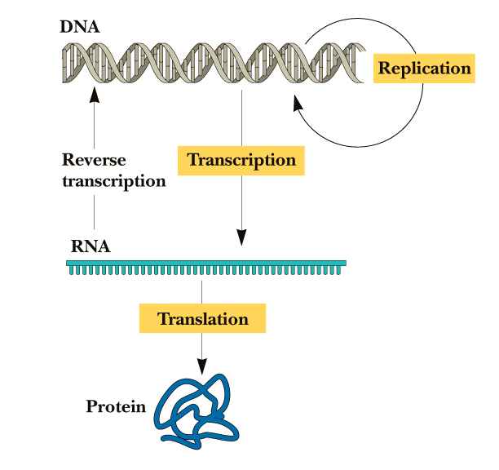
Flow of Genetic Information
Recombination
Mutation/Repair

Slide 4
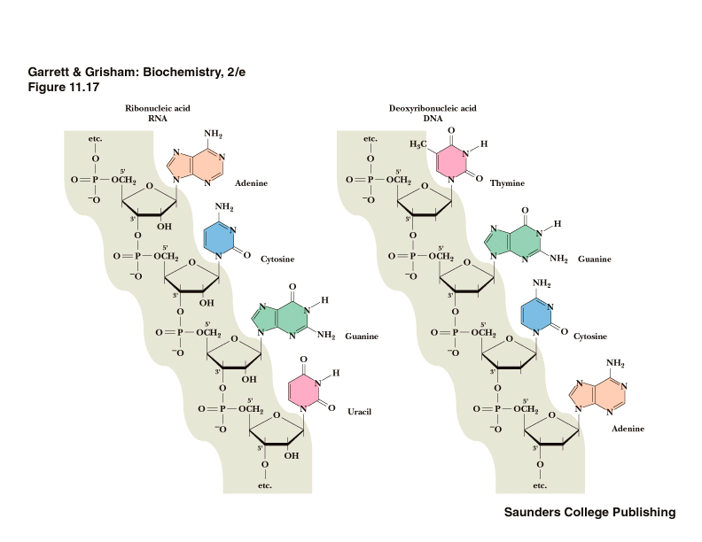
Similarities and Differences Between DNA and RNA
RNA
DNA
Similar strand structure
Can define a 5’ and 3’ end
2’ hydroxyl in RNA
(causes stability differences)
Uracil in RNA not in DNA

Slide 5
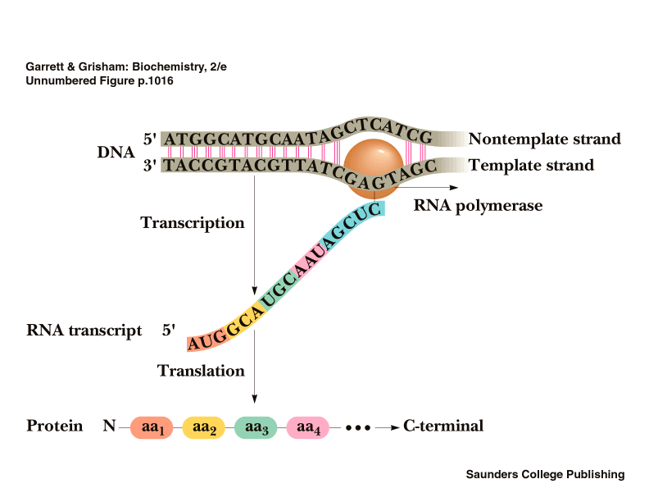
Some nomenclature conventions
(sense strand)
(coding strand)
RNAP
(anti-sense strand)
(non-coding strand)

Slide 6
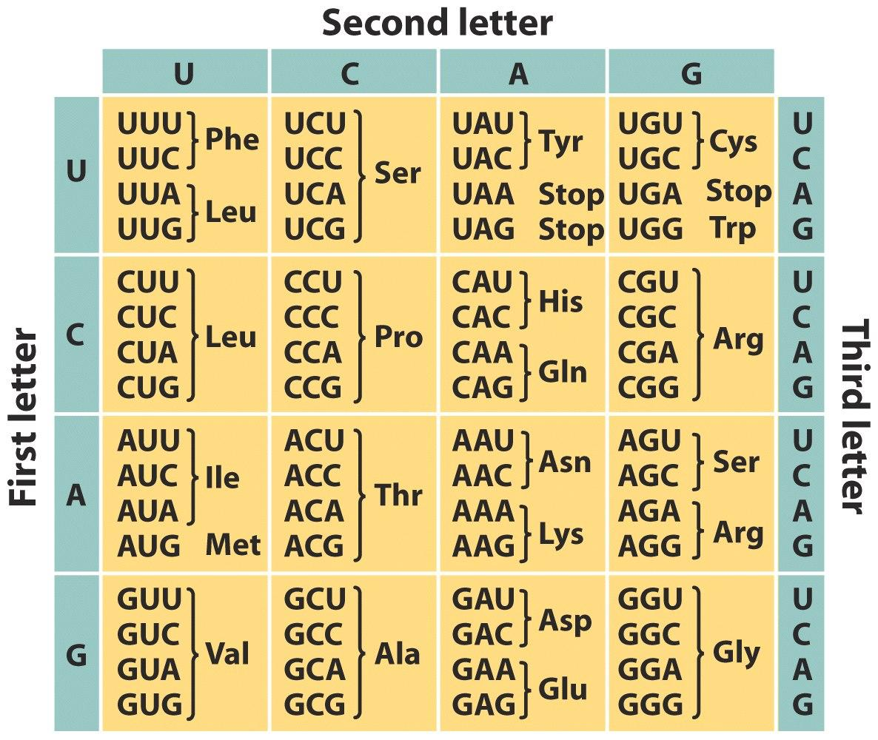

Slide 7
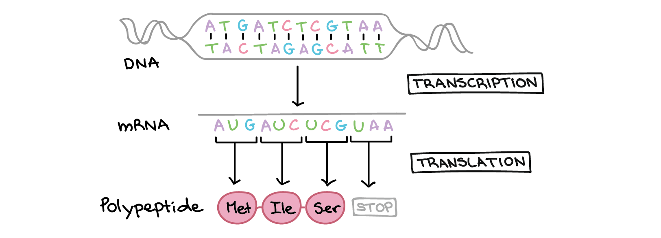
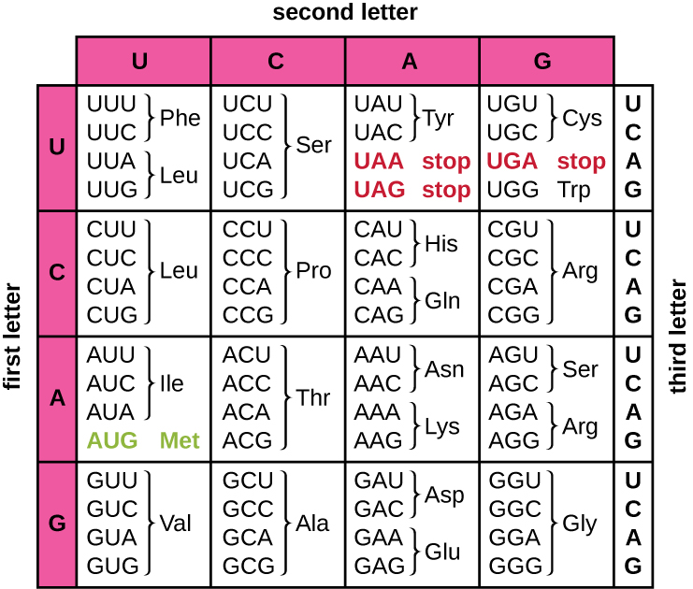
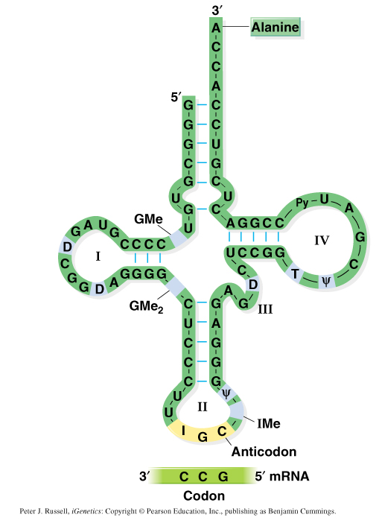

Slide 8
Other important nomenclature conventions
Transcription Initiation Site
“Upstream”
“Downstream”
-5
-4
-3
-2
-1
+1
+2
+3
+4
+5
+6
5’
3’
3’
5’
Direction of transcription
Template strand
There is no “zero”

Slide 9
Bacterial (Prokaryotic) Transcription
Promoters
- DNA sequences that guide RNAP to the beginning of a gene (transcription initiation site).
Terminators
- DNA sequences that specify then termination of RNA synthesis and release of RNAP from the DNA.
RNA Polymerase (RNAP)
- Enzyme for synthesis of RNA.
Reaction (ordered series of steps)
1) Initiation.
2) Elongation.
3) Termination.

Slide 10
A promoter can be defined in two ways.
The sequence of DNA required for accurate, specific intiation of transcription
The sequence of DNA to which RNA polymerase binds to accurately initiate transcription.

Slide 11
